Slide 1
Variables and keywords in c
A variable in simple terms is a storage place which has some memory allocated to it. Basically, a variable used to store some form of data. Different types of variables require different amounts of memory, and have some specific set of operations which can be applied on them.

Slide 2


Variable declaration
type variable_name;
or for multiple variables:
type variable1_name, variable2_name, variable3_name;

Slide 3
Rules of defining variables
A variable can have alphabets, digits, and underscore.
A variable name can start with the alphabet, and underscore only. It can’t start with a digit.
No whitespace is allowed within the variable name.
A variable name must not be any reserved word or keyword, e.g. int, goto , etc.

Slide 4
Types of Variables in C
1. Local Variable A variable that is declared and used inside the function or block is called local variable. It’s scope is limited to function or block.It cannot be used outside the block

Slide 5
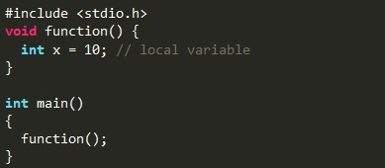
Local variables declaration

Slide 6
global variables declaration
2. Global Variable A variable that is declared outside the function or block is called a global variable. It is declared at the starting of program. It is available to all the functions.

Slide 7
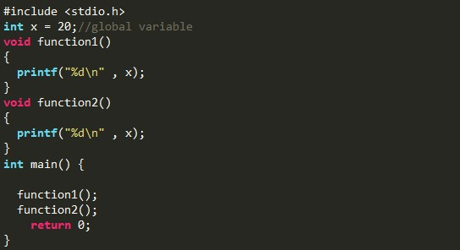
global variables declaration

Slide 8
static variables declaration
3.Static Variable A variable that retains its value between multiple function calls is known as static variable. It is declared with the static keyword.

Slide 9
What is keywords ?
Keywords are specific reserved words in C each of which has a specific feature associated with it. Almost all of the words which help us use the functionality of the C language are included in the list of keywords. So you can imagine that the list of keywords is not going to be a small one!

Slide 10
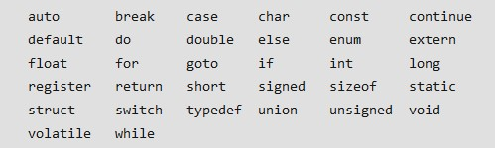
THERE ARE 32 KEYWORDS IN C

